Slide 1
Root cause problem solving…the heart of a lean transformation
Notes:
1-quality consultants…we specialize in cultural change, check out our website at www.qc-ep.com
2- the biggest cultural changing mechanism in mfg is lean…..and specifically we specialize in lean revitalizations, those how have tried and failed
3- problems with lean definition, to me its tps lean, no other way

Slide 2
Lonnie Wilson
Author, How to Implement Lean Manufacturing
Principal Consultant, Quality Consultants
law@qc-ep.com
Sam Bernstine Principal, Kepner-Tregoe, Inc. SBernstine@kepner-tregoe.com

Slide 4
Introduction
Who we are and our specialty
Cultural change and the power of Lean Done Right
What does “Lean Done Right” look like??
Notes:
1-quality consultants…we specialize in cultural change, check out our website at www.qc-ep.com
2- the biggest cultural changing mechanism in mfg is lean…..and specifically we specialize in lean revitalizations, those how have tried and failed
3- problems with lean definition, to me its tps lean, no other way

Slide 5
Lean Done Right! The Theta Cell, Labor Productivity over Time
Management 1.0 Management 2.0 Management 3.0
300
304
225
188
Productivity
(Headrests/person/day)
---Product is very profitable--
150
Productivity Target 100
75
-----------Product is losing money----------
80
65
SOP
I YR
2 YR
3 YR
Time
Slide information extracted from “Lean Refining: How to Improve Productivity in the Oil Industry”, (Industrial Press, 2017)
Notes:
1-This value stream had struggled to meet the needed levels of productivity to get in the black
2-Started at 65 after ppap, many projects with quality, delivery efforts and lots of visits from the home office..stuck at 80, 2 years later
3-Using a lean approach we performed a kaizen event and in one week improve prod to 188 hpppd
4-Then using a fully engaged workforce and literally hundreds of worker led and implemented kaizens we got to 304
5-That’s lean done right
This story is a complete chapter in my book, “Lean Refining” and it is available on amazon in multiple formats and available throught the publishere, industrial press
Before we go much further we would like to get some input from you on your improvement methods
And we’ll have the responses in a few slides after the results are compiled…..

Slide 6
POLL: Are you using lean as a process and product improvement methodology?
Yes, all in
Yes, but have limited management commitment
Yes, but are just dabbling
Yes, but really are “pretending to do lean”
We tried but gave up
No, we are using another continuous improvement methodology
No, we have no continuous improvement methodology

Slide 7
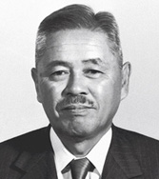
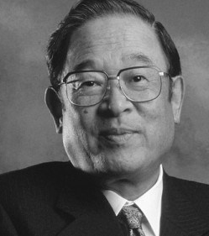
The confusion: How do we define this thing called lean manufacturing?
Many definitions…some good, some not so good
Originally, lean was defined as the replication of the Toyota Production System (TPS); that is the lean manufacturing I teach:
Following the writings of Taiichi Ohno and Fujio Cho
Following the guidance of the green 13 page pamphlet called “The Toyota Way, 2001”(not the full length book by a similar name)
This is a description not only of the TPS, but the entire culture of the Toyota Motor Corporation
Lets take a look at lean manufacturing from 30,000 feet
Taiichi Ohno
Fujio Cho
Notes:
big part of the confusion…is just what is this thing called lean manufacturing
What is lean … with the implementation of lean is just what is lean and there is a lot of confusion. Mostly because people have tried to implement and failed and so redefined it to something that was both…easier to do and easier to sell…..certainly consultants like myself have morphed the tps out of shape for self serving reasons
Mine is…..the only writings of Toyota by Toyota top level managers. Others have written about mostly academics who observered rather than worked in the tps
To become lean…..this is an integrated definition defined to address all three constituencies of your facility…the stockholders, the employees and the customes…tps lean is an integrated system

Slide 8
Lean in stakeholder terms
Is becoming better, faster and cheaper as you work to make your facility:
A better money making machine;
That is a more secure workplace for your employees; and
The supplier of choice to your customers
Notes:
What is lean intro… with the implementation of lean is just what is lean and there is a lot of confusion. Mostly because people have tried to implement and failed and so redefined it to something that was both…easier to do and easier to sell…..certainly consultants like myself have morphed the tps out of shape for self serving reasons
Mine is…..the only writings of Toyota by Toyota top level managers. Others have written about mostly academics who observered rather than worked in the tps
To become lean…..this is an integrated definition defined to address all three constituencies of your facility…the stockholders, the employees and the customes…tps lean is an integrated system

Slide 9
How do we “do” Lean?
Lean is the creation of a culture of:
Continuous Improvement and
Respect for people
The means to Lean is to:
Problem solve your way to the Ideal State
Through the total elimination of waste
Using a fully engaged workforce
It all starts with Problem solving…not just any problem…
Notes:
Lean defined as Toyota defines their culture
The means to lean…..designed to answer the question at tyeh operationsal level….what must i do to become lean, that is the means to lean…and you can see where it starts
What lean is not…
The jargon of lean
the tools of lean which is the typical deployment method
It all starts with problem solving….well not just solving any problems but those problems that are preventing you form attaining the ideal state

Slide 10
But there are issues…
Lean is not working very well in many places
70% are trying, few are succeeding. Of this 70%...
Just why is this?
Notes:
3-70% are trying, less than 2% are successful.....24% are achieving significant results the majority..over 70% are struggling

Slide 11
Just why are these lean transformations not effective?
There are many issues, but the six biggies:
Thinking of lean as a “tools” issue
Copying, sometimes called benchmarking
Trying a staff-led, staff taught program
Using a “bolt on” philosophy
Improperly integrating the management team
Commitment issues
Leadership deficiencies
A management system completely dominated by short-term, bottom-line thinking
Notes:
1-explain the tools metaphor…the way they roll it out and the mechanic metaphor…don’t start with the tools, start with the problems to solve
2-Copying never works…everyone’s issues are different…an excuse for not thinking deeply
3-try to use “staff experts” to deploy the program…never works, conflicting priorities
4-presume that lean can just be added and the underlying management system is adequate….an error in logic of massive proportions
5-don’t properly integrate the management team..usually try ot lead the effort with a highly motivated mid level manager…never works

Slide 12
Summarizing the issues
There is not fundamental weakness in what the TPS is, rather the weakness is how people go about transforming their business to a lean enterprise
It is a matter of execution.
Those who are not achieving success in their lean transformations are simply failing to do what Toyota did
Taiichi Ohno said, “The TPS was developed out of necessity”
Hence you need to find “your necessity” so you can become “better, faster and cheaper”
Then the task is to develop processes and procedures to reach those goals
Notes:
IN JUST A MINUTE WE WILL DISCUSS PROBLEM SOLVING TO REACH THE IDEAL STATE….BUT NOW WE WILL BREAK FROM THE AGENDA TO ANSWER THE LARGE LIST OF QUESTIONS WE ARE ACCUMULATING….THANK YOU FOR BEING SO ACTIVE……THE MORE QUESTIONS THE BETTER…..Sam, what do we have??

Slide 13
Questions?
Notes:
Questions – If none from the audience:
1) Don’t you think you are being unduly negative?? 2) Seems like everyone starts with 5S..what’s wrong with that?? 3) How come there are so many success stories in the literature??
Unduly negative…not at all, I am very positive about the potential of lean…but I am equally positive there are many problems… you can read about the 6 Roll Out Errors and the 10 Lean Killers and if you’d like to discuss them as they fit your situation, please call….i always have time to help
Success stories abound, no problem, I will give you several before we are done…..however, the question is what is that facility doing 4 years later. The truth is to become lean is not so daunting a task..although few do it..to remain lean is

Slide 14
“If you don’t know where you are going, you might end up somewhere else.” -Yogi Berra
What’s the Ideal State?
The beauty of the Ideal State…..
In lean manufacturing, in the TPS, that is the world with zero waste….
One piece flow over zero distance
Zero inventory,
No WIP
Zero defects
No one is waiting
No excess movements
No over processing
No accidents and
High morale
Our questions are no longer what to do…
But when, how, and in what order?
It all starts with: Problem solving to reach the Ideal State
Notes:
Ideal state…..a hoped for end state…maybe not even a reality TODAY, but is has the beauty that the destination is no longer the issue, rather the issue is when and how much to work on

Slide 15
“You’ll never find a rainbow if you are looking down” - Charlie Chaplin
We employ the Initiative Mantra
The unreachability of the Ideal State?
Says who?
We start where we are
We use what we have
We do what we can
We call this:
“the no-more-excuses rule”
Notes:
Ideal state…..a hoped for end state…maybe not even a reality TODAY, but is has the beauty that the destination is no longer the issue, rather the issue is when and how much to work on
Mark Twain said,…no one told them it was impossible, so they just did it
Benjamin franklin said…he who is good for making excuses, is seldom good for anything else
Dave Laroche speech…….

Slide 16
Just how do we go about getting there?
It all starts with: Problem Solving to reach the Ideal State
How do we start?
It all starts by looking at our destination:
Better…ever improving product and process quality
Faster…ever improving customer service and reduced lead times
Cheaper…at an ever reducing cost
Developing gaps between where we are and where we want to be, which is a natural development from structured problem solving
Prioritizing those gaps and then deploying them fully using a fully engaged workforce
Those gaps are now concerns and they take three forms:
Gaps that are future issues/Potential Problem Analysis
Gaps that are simple decisions/Decision Analysis
Gaps that are problems - they are present issues of concern where the root cause needs to be removed for progress to be make/Problem Analysis
Notes:
Ideal state…..a hoped for end state…maybe not even a reality TODAY, but is has the beauty that the destination is no longer the issue
3,4,5,-Deploying them fully….using HK Planning with “catchball” and KT decidions making is a good tool to use in priortizign as well

Slide 17
How do we go about handling these concerns? What about problem solving?
The workhorse is the Six Questions of Continuous Improvement
1
What is the present condition?
2
What is the desired future condition?
3
What is preventing us from reaching the desired condition?
4
5
6
What is something we can do, right now, to get closer to the desired condition?
When we do this, what should we expect?
b. How much of it will happen?
c. When will it happen so we can “go see?”
What have we learned?
a. What will happen?
And there are others such as the Shainan Toolkit, the Six Sigma statistical tools, the 5 Whys etc…
each has a niche

Slide 18
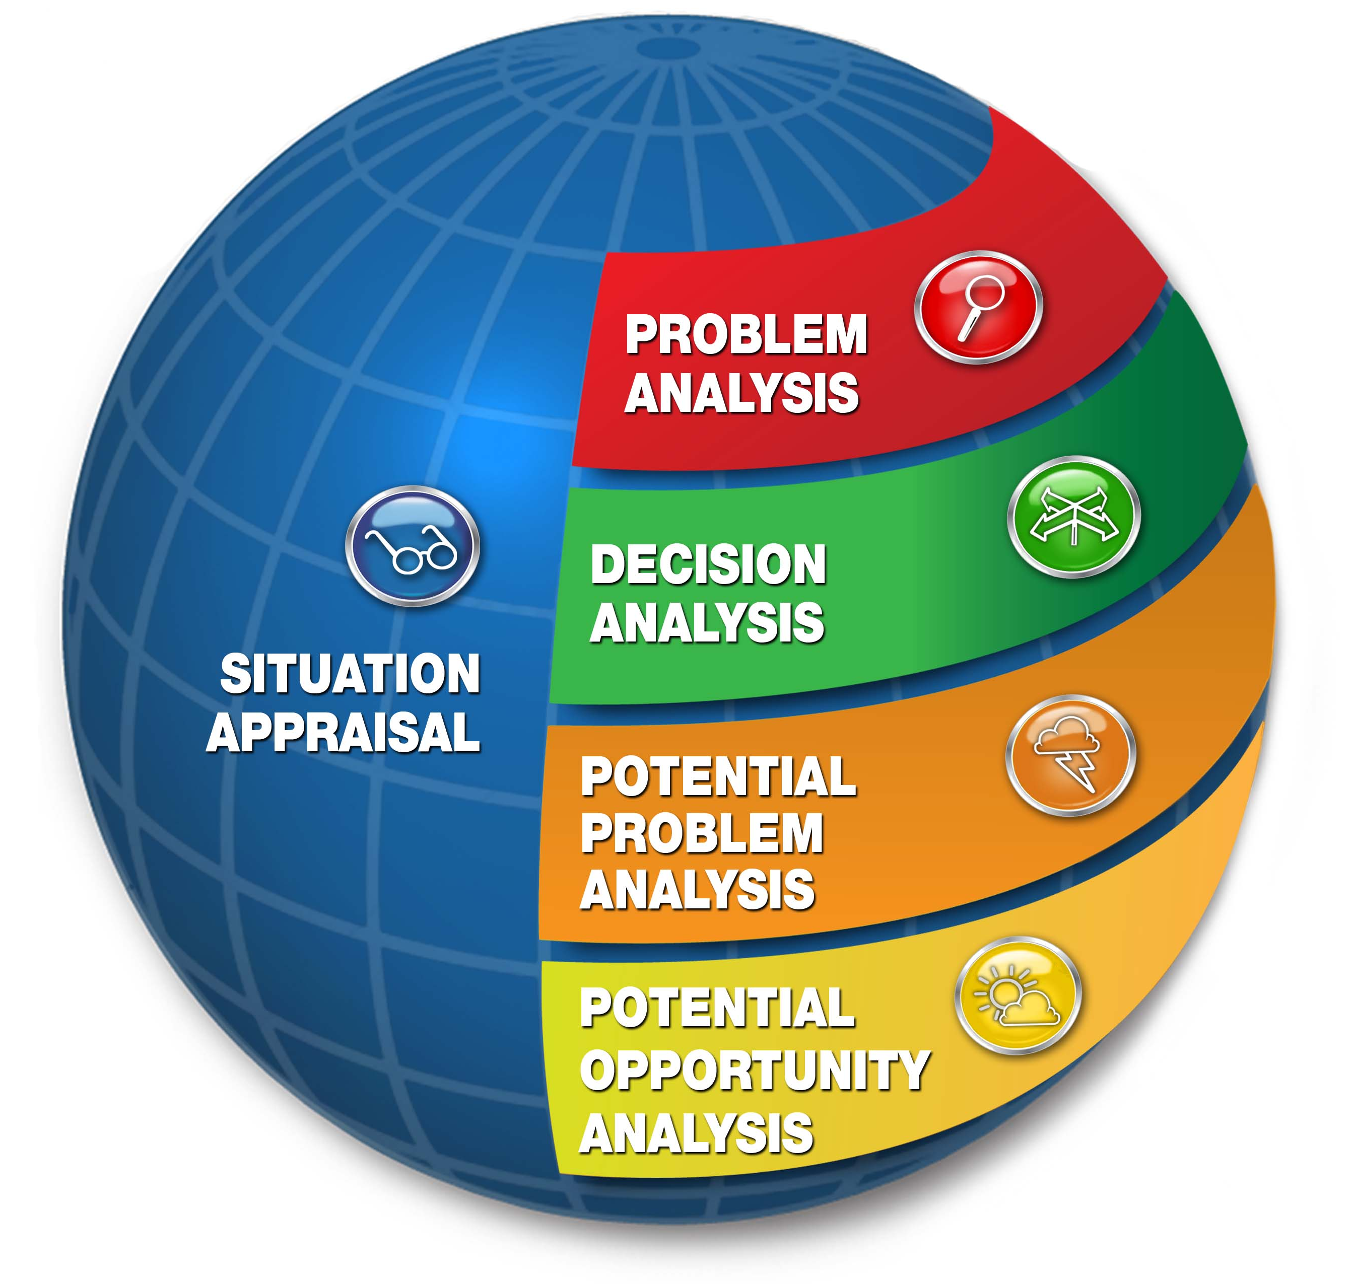
What about the toughest and the largest of the problems to solve -- what then?
The most powerful technique by far is problem solving following the Kepner-Tregoe method
Used for the biggest, toughest and most consequential problems
The heart of the method is the Problem Analysis process using the 4 dimensions of “what”, “where”, “when” and “extent” to “box in a problem”. This identifies where the problem “is” as well as where it “is-not”.
Problem Analysis is an approach to better understand the problem, and it does not stop with those 4 dimensions.
The “is-not” questions now raise the dimensions from 4 to 8 and logically expand your database
The case of the bent pins in manufacturing a sophisticated circuit board…the power of the is/is-not analysis
Notes:
These dimensions often have several questions to help “box in” and define the problem…e.g. under the “when dimension” you may ask “when in the life of the part did it fail, when in the process did it fail, when during the day did it fail etc
For every “Is” question, there is a complementary “Is not” question. The true genius of the method is not fully appreciated until you ask the “Is not” questions. For example, “when could the part have failed, but did not?”, or “Where could the part have failed, but did not?”.
The bent pins issue…expand on notes later…..tugger tipped over box, corrugated eggcrate dividers were install upside down….tugger path was 6” too narrow…..widened

Slide 19
What are the “problems” with problem solving??
Strangely enough I have found that finding solutions is seldom an impediment to good root cause problem solving. At least 90% of the time, when root cause is not found it is due to:
Failure to properly define the problem and/or
Failure to use a structured disciplined approach
Unfortunately this is “news” to many…
The case of the fouling heat exchangers…a repeating issue…or was it?
Notes:
This was a “repeating” problem…or so they thought. They had worked months, spend over 100 MDs in problem solving with no solution in sight….
The RF manager was aware is was proficient in KT techniques and asked me to get involved…we convened a team the next day. I was apprised of the problem as heat exchanger fouling which souuunded like a similar past problem……

Slide 20
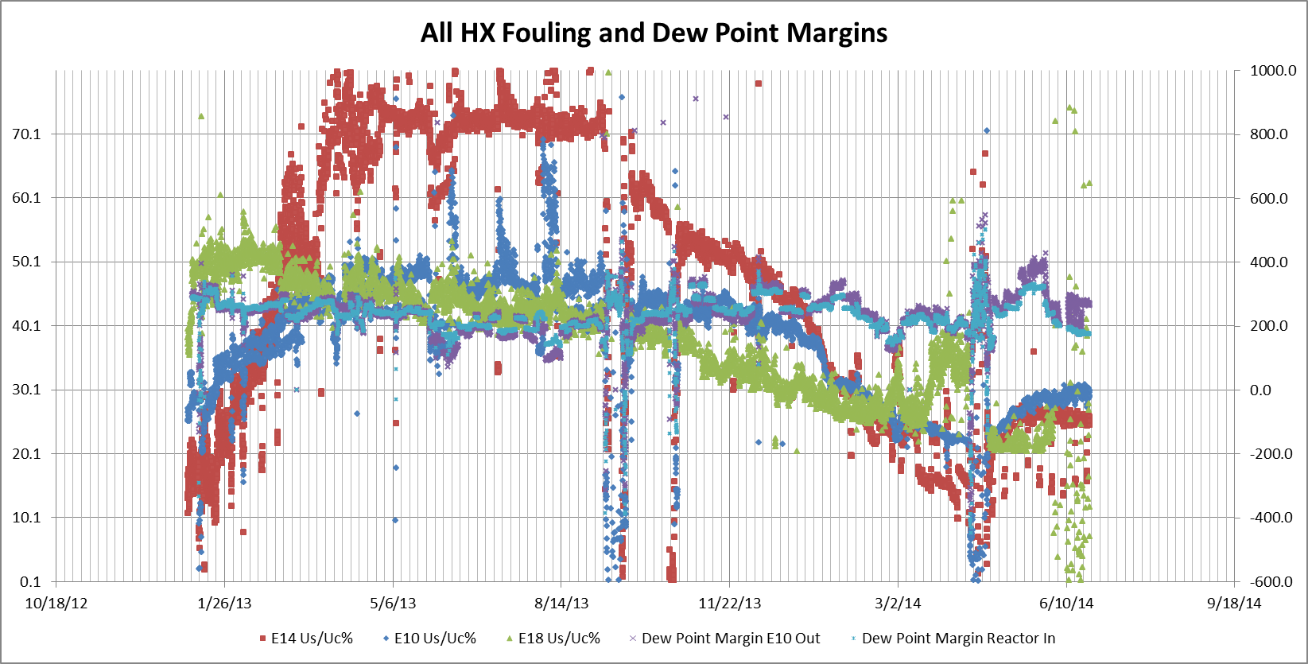
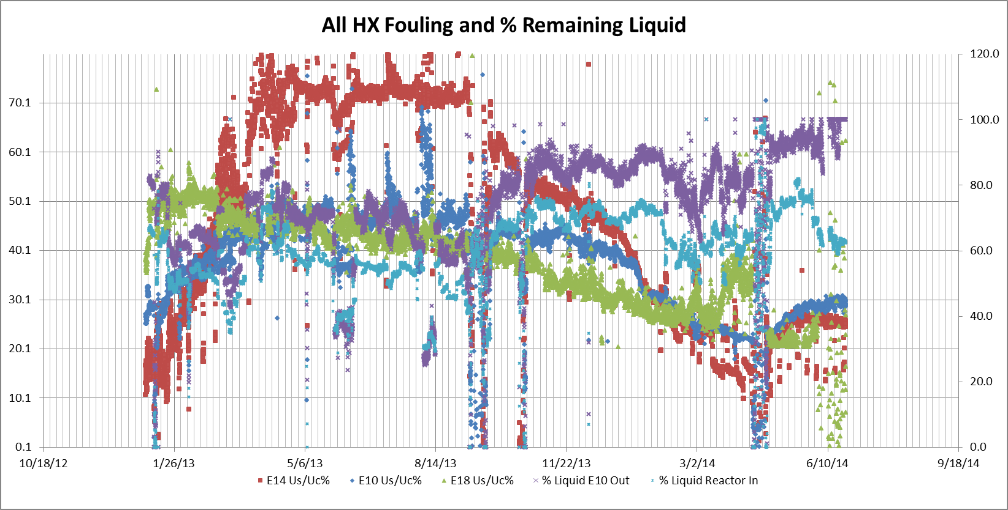
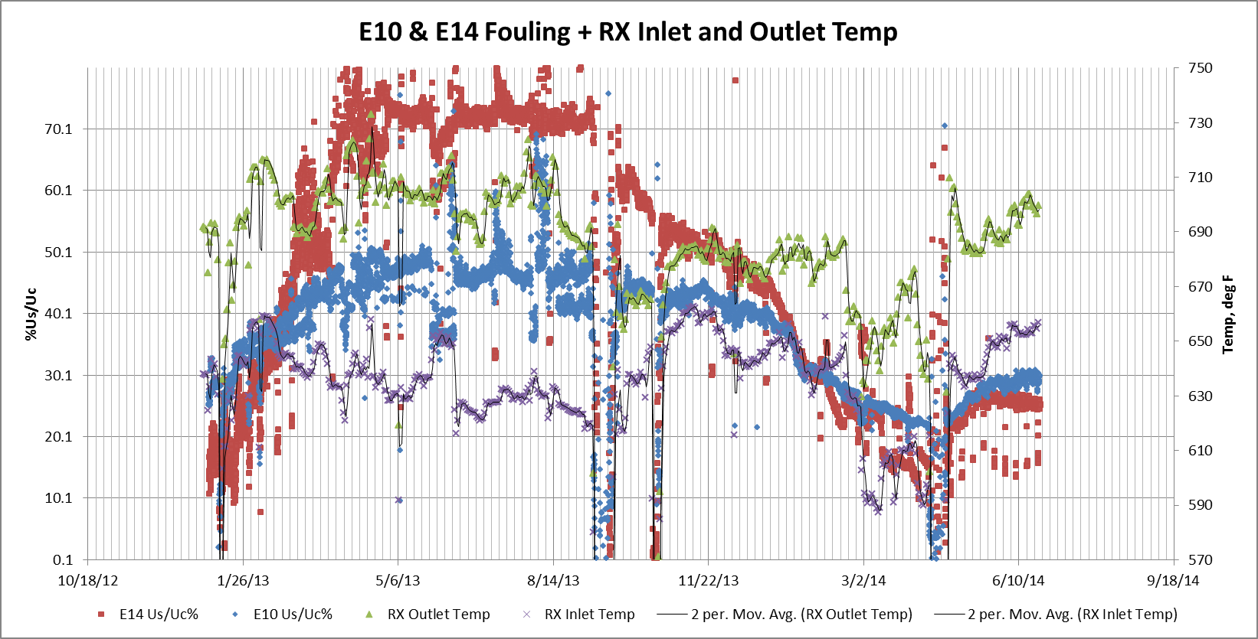
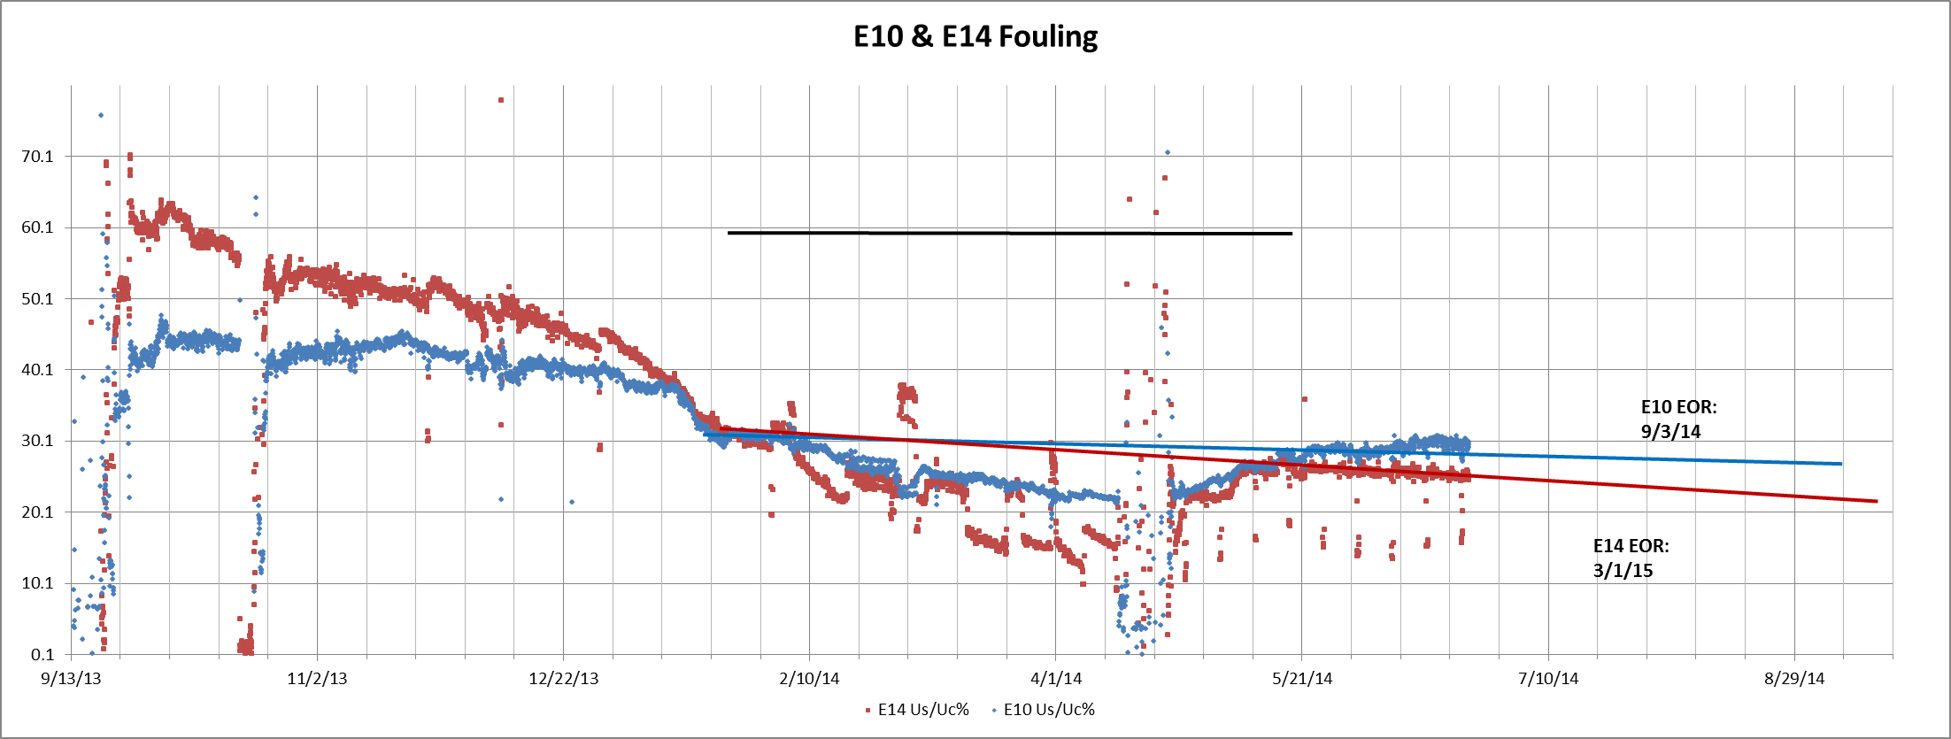
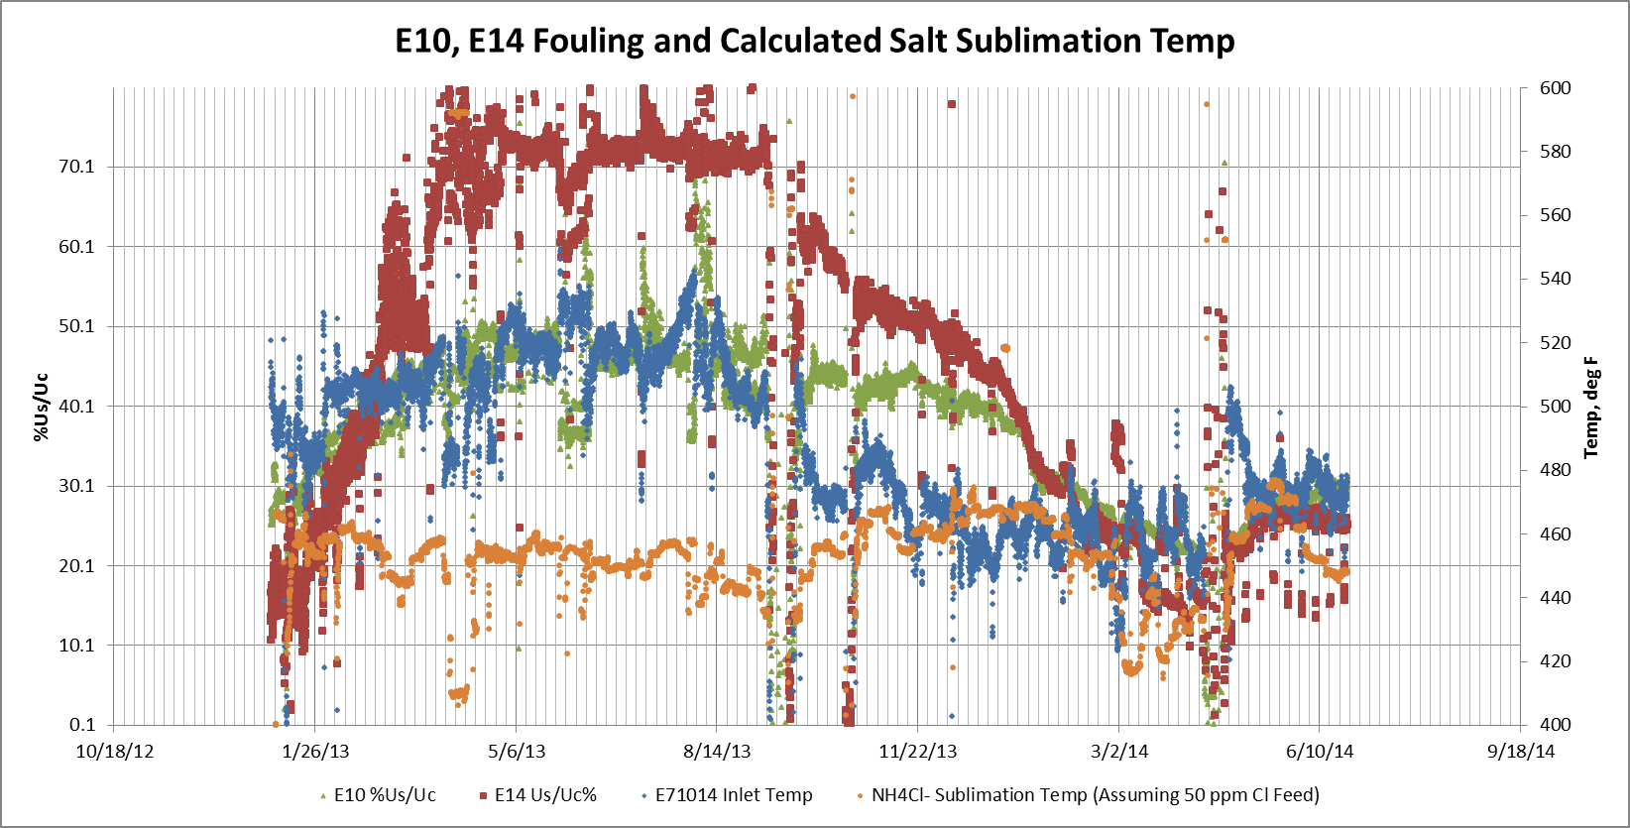
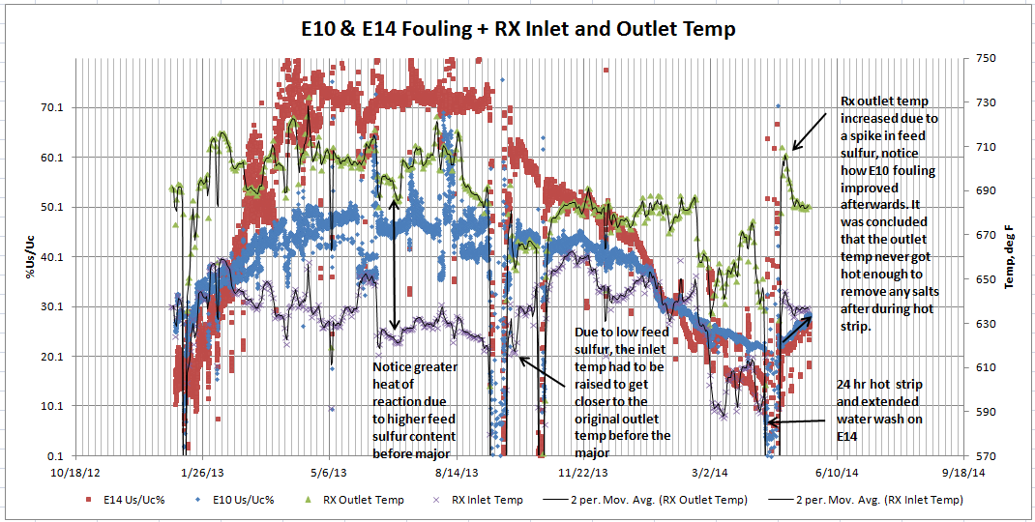
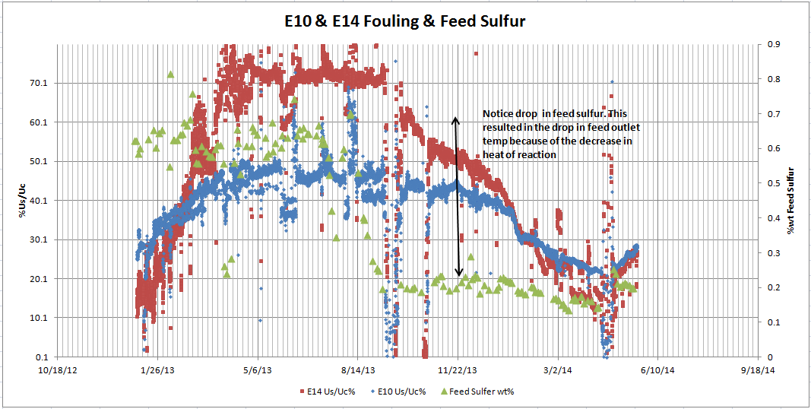
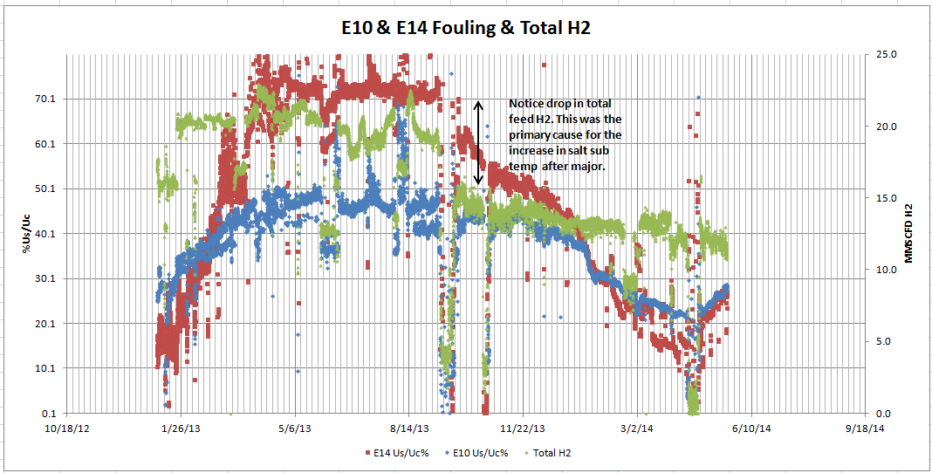
“We are drowning in data…but starving for information” - Wilson
Notes:
We were awash in data……but regardless we began by filling out a kt situation appraisal……
We “believed” we knew the problem, but were not able to see it….we are stuck…not stuck for lack of data, but stuck because we “knew” the problem

Slide 21
“I’ll see it when I believe it” - a slip from psychologist Thane Pittman
The heat exchanger fouling issue
Kepner-Tregoe Problem Analysis
Describe Problem | Identify Possible Causes | Evaluate Possible Causes
Aliquam feugiat eros a eleifend mollis. Nulla a bibendum mi, consectetur elementum risus. Nunc ac nisi a diam tincidunt molestie ac non ipsum. Vestibulum dapibus maximus tortor, sed semper felis sollicitudin et. Cras diam mi, rhoncus sit amet vehicula mollis, sodales ut dui. | Donec eros nunc, consectetur et tempor eget, placerat vitae erat. Nam semper convallis diam, nec ultricies nisi lacinia sit amet. Vestibulum dapibus maximus tortor, sed semper felis sollicitudin et. Cras diam mi, rhoncus sit amet vehicula mollis, sodales ut dui. Vestibulum dapibus maximus tortor, sed semper felis sollicitudin et. Cras diam mi, rhoncus sit amet vehicula mollis, sodales ut dui. | Sed pulvinar mauris ante, eu blandit dui feugiat nec. Sed blandit est sit amet dui viverra laoreet. Vestibulum dapibus maximus tortor, sed semper felis sollicitudin et. Cras diam mi, rhoncus sit amet vehicula mollis, sodales ut dui.
WHAT | IS | IS NOT
Vivamus tempor est venenatis risus semper porttitor quis id eli Vestibulum dapibus maximus tortor, sed semper felis sollicitudin et. Cras diam mi, rhoncus sit amet vehicula mollis, sodales ut dui. t. Quisque lobortis at quam id efficitur. Duis eu vulputate massa, ut fermentum nulla. Integer cursus nisi ut ligula auctor, sed tristique justo mattis. | Suspendisse porta laoreet odio vitae facilisis. Aliquam vestibulum, lacus eget maximus tempus, magna tellus pulvinar nisl, sit amet scelerisque massa augue non felis. | Fusce sagittis turpis non purus vehicula, nec convallis erat facilisis. Quisque lobortis at quam id efficitur. Duis eu vulputate massa, ut fermentum nulla. Integer cursus nisi ut ligula auctor, sed tristique justo mattis.
WHERE | IS | IS NOT
Quisque lobortis at quam id efficitur. Duis eu vulputate massa, ut fermentum nulla. Integer cursus nisi ut ligula auctor, sed tristique justo mattis. | Phasellus eleifend magna nec lorem maximus, at feugiat mi lobortis. Donec vel quam nec tellus ultrices tincidunt. Vestibulum dapibus maximus tortor, sed semper felis sollicitudin et. Cras diam mi, rhoncus sit amet vehicula mollis, sodales ut dui. | Vestibulum dapibus maximus tortor, sed semper felis sollicitudin et. Cras diam mi, rhoncus sit amet vehicula mollis, sodales ut dui.
WHEN | IS | IS NOT
Aliquam feugiat eros a eleifend mollis. Nulla a bibendum mi, consectetur elementum risus. Nunc ac nisi a diam tincidunt molestie ac non ipsum. | Donec eros nunc, consectetur et tempor eget, placerat vitae erat. Nam semper convallis diam, nec ultricies nisi lacinia sit amet. | Sed pulvinar mauris ante, eu blandit dui feugiat nec. Sed blandit est sit amet dui viverra laoreet. Vestibulum dapibus maximus tortor, sed semper felis sollicitudin et. Cras diam mi, rhoncus sit amet vehicula mollis, sodales ut dui. Vestibulum dapibus maximus tortor, sed semper felis sollicitudin et. Cras diam mi, rhoncus sit amet vehicula mollis, sodales ut dui.
EXTENT | IS | IS NOT
Quisque lobortis at quam id efficitur. Duis eu vulputate massa, ut fermentum nulla. Integer cursus nisi ut ligula auctor, sed tristique justo mattis. | Phasellus eleifend magna nec lorem maximus, at feugiat mi lobortis. Donec vel quam nec tellus ultrices tincidunt. Quisque lobortis at quam id efficitur. Duis eu vulputate massa, ut fermentum nulla. Integer cursus nisi ut ligula auctor, sed tristique justo mattis. | Vestibulum dapibus maximus tortor, sed semper felis sollicitudin et. Cras diam mi, rhoncus sit amet vehicula mollis, sodales ut dui.
Notes:
When we started to write the problem definition it soon became clear we did not know the problem…we believed we knew the cause of the problem, hence that is the data we were looking for…..when we were forced to first, properly state the problem, it became apparent we had a different problem and once we “believed that” then we could begin to “see” the problem

Slide 22
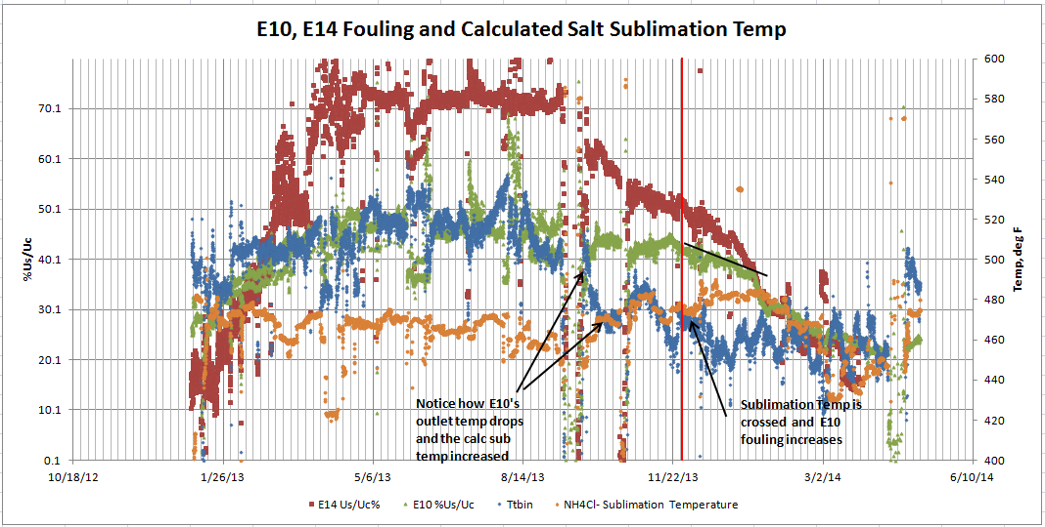
“A problem well defined, is a problem 90% solved”- Wilson
Notes:
This graph provided clarity..the first line is the “should be” state of the heat exchanger performance, the second line is the “is state”
So in KT terms, we found a “deviation” and from there it was childs play to find the root cause and implement countermeasures…….it was the problem definition and the use of the 8 dimensions we used to Box in the problem

Slide 23
A key metric in this lean transformation was to improve OEE
Notes:
In yet another lean transformation a key driver was the overall equipment effectiveness of the production process……..
We started at less then 70% which for this plant was disastrously low and you can see we made strong and steady improvement over the next 17 months.
The process made foam seating for the auto industry. There was a large carousel with many molds and parts were poured, cured and demolded in a continuous process. For any given part number, for quantity reasons, there were often multiple, but identical, molds.
We began our journey with marginal success then decided we needed to implement KT problem solving. Early on, as I was teaching them the KT methods, I asked one is not question. Specifcally, where could these defects be coming from but are not? Once brave soul mentioned that although the molds were identical, on occasion there were differences in quality performance…..that turned out to be an understatement…..

Slide 24
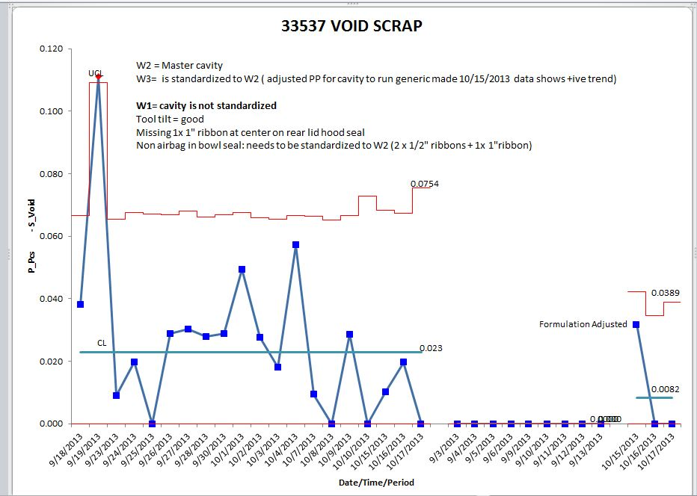
The “identical” molds…How one simple question can create an avalanche of diamonds…
Mold 1
Mold 2
Mold 3
Notes:
While working to improve plant fty, we were using the KT methodology and asked…what was the defect and where was the defect and we found it on pn 33537
Then we asked the when question and showed that the defect was happening all the time…THEN when we asked, “where could it be happening but is not?”, someone said that maybe the different mold cavities…which are supposed to be identical…may perform differently….and we got this graph believed that mold one was the best……..hah!!!
Using these graphs we not only found the problems…but the soluutions as well…..I told you solutions are normally not an obstacle
Now we will ask for some information from you in another on line poll……

Slide 25
POLL: Do you have a structured problem solving methodology?
No
Yes, but it is used only by engineers, supervisors and managers on production and process problems
Yes, but it is not widely taught
Yes, but problems frequently repeat
Yes, but not used in a crisis
Yes, it is used on all problems by everyone

Slide 26
The residual effect and integration
Those who practice structured, disciplined problem solving such as the Six Questions of Continuous Improvement or the KT methodology are both faster and clearer thinkers who are able to solve problems in real time.
They use a logical and integrated process that assists them at all times.

Slide 27
A final word or two
Check out our website at www.qc-ep.com which features:
Information including a library with 700 books, each with a summary available
Over 50 published White papers mostly dealing with the human side of lean and several about consulting
Look for “Change Agents Beware: Weirdness, Survival and Success” about the Perceived Weirdness Index
A pulldown menu on Lean Manufacturing, forms for problem solving and more
All the examples covered in this presentation are more fully developed and explained in one of my books:
“How to Implement Lean Manufacturing” (McGraw Hill, 2009, 2015) - This book was an Amazon #1 Best Seller
“Lean Refining: How to Improve Productivity in the Oil Business” (Industrial Press, 2017) – Describes how lean can apply in the continuous process industries just as it works in the discrete part assembly industries
Last but not least, anyone who has ever been a student can continue to be one if they so choose. Having completed this webinar, I now count you as one. Hence I am available for ad hoc questions, teaching and mentoring. Just email or call!
Be well…Lonnie
Notes:
And now we have a long list of questions to address, so i will turn this over to sam…what questions do we have??

Slide 28
Questions?
Notes:
Questions – if none from the audience:
1) Several people have asked, why do you not discuss “value” as the driving force for lean implementation as many gurus suggest? 2) Why do you seem to be so “down” on the academics??
Unduly negative…not at all, I am very positive about the potential of lean…but I am equally positive there are many problems… you can read about the 6 Roll Out Errors and the 10 Lean Killers and if you’d like to discuss them as they fit your situation, please call….i always have time to help
Success stories abound, no problem, I will give you several before we are done…..however, the question is what is that facility doing 4 years later. The truth is to become lean is not so daunting a task..although few do it..to remain lean is

Slide 29
Lonnie Wilson
Author, How to Implement Lean Manufacturing
Principal Consultant, Quality Consultants
law@qc-ep.com
Sam Bernstine Principal, Kepner-Tregoe, Inc. SBernstine@kepner-tregoe.com

